Slide 1
Program Strategy & Evaluation
Paul Brest and
Erinn Andrews
June 2019

Slide 2
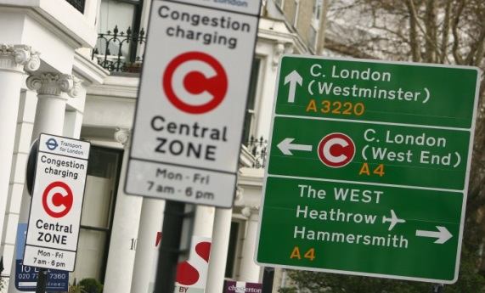
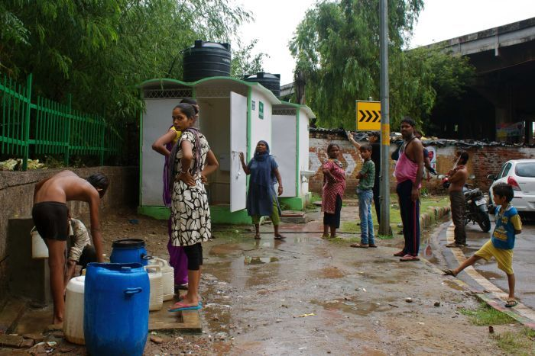

Slide 3
Problem-solving process
Identify the problem and intended outcome
What's the problem you are trying to solve, for whom is it a problem, and why is it important?
Who are your intended beneficiaries?
What are causes of the problem?
How big a part of the problem do you want to tackle and what approach will you take—in terms of scope, timeframe, and strategic tools?
What's your intended outcome?
Tentatively choose a promising approach (strategic pathway) to solving the problem.
Develop a strategy to achieve the outcome
What's the theory of change leading to the outcome?
What stakeholders may be affected by your solution?
What are major weaknesses in your theory of change, and barriers to achieving your goals? How will you overcome them?
What are the beneficiaries' needs?
Identify behavior changes needed for your plan to succeed. How will you achieve them?
How would your proposed solution affect and be affected by the broader system in which the problem and solution exist?

Slide 4
Problem-solving process, cont.
Implement the strategy
Draft an action plan for the strategy.
Specify metrics and targets for assessing progress as you implement the strategy.
Specify outcome metrics and targets, based on which the organization's effectiveness and your own performance will be evaluated.
Adjust strategy/implementation based on feedback.
Evaluate the strategy
Design a plan for evaluating the impact of your strategy.
Scale the program
Identify problems in replicating or scaling the program.

Slide 5
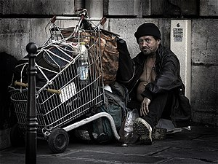
Problems for today’s workshop
PAUL: Homelessness in the U.S.
YOU: Global Obesity Among Young Adults

Slide 6
Defining the Problem & Identifying Stakeholders
What is the problem you are trying to solve, for whom is it a problem, and why is it important?
What are the causes of the problem?
Who are your intended beneficiaries, and what are their needs?
Who else is tackling the problem and how might you collaborate?
How big a part of the problem do you want to tackle and what approach will you take?
What is your intended outcome?

Slide 7
Defining the Problem
“If I had 60 minutes to solve a problem and my life depended on it, I’d spend 55 minutes determining the right question to ask.”
Albert Einstein

Slide 8
Describe the Problem
I am the executive director of a new nonprofit organization called Against Homelessness, funded by a philanthropic couple, Peggy and Fred Gordon. The Gordons would like to start with a pilot program in their city populated by about 1 million people.
What’s the problem the Gordons wish to solve?

Slide 9
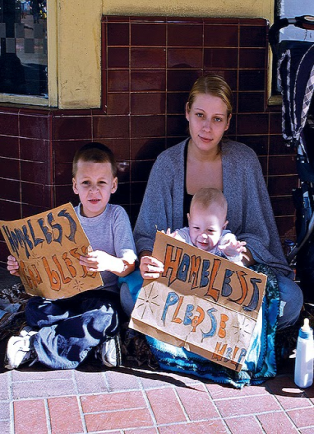
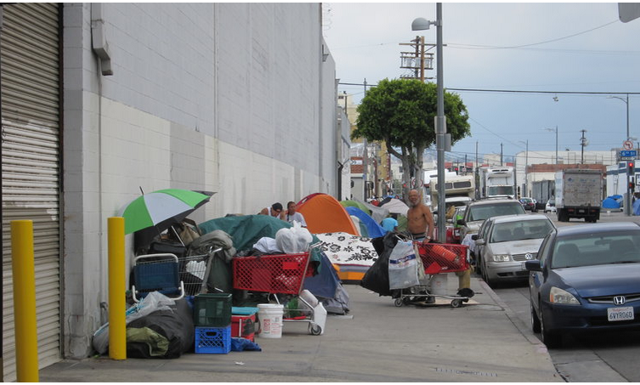
Notes:
The way that any of us think of a problem is affected by our preconceptions and personal experiences. And this is true of the Gordons’ understanding of the problem of homelessness in their city.
For instance Fred and Peggy encounter different groups of homeless people in the street as each travels to work.
Fred sees a homeless mother and child begging for money.
Peggy sees a cluster of people who are homeless crowding the street in front of her office, living in a makeshift settlement that seems unhygienic to her. These are the people they have in mind when they define the problem that your organization is trying to solve.

Slide 10
Get to the heart of the problem: Fred
Q. Why is homelessness a problem?
A. Homeless families need shelter.
Q. That sounds more like a particular solution. We’ll come to solutions later. But first, why is homelessness a problem?
A. Because no one should have to live on the streets.
Q. Why is living on the streets a problem?
A. People are exposed to the elements—cold, rain, snow, heat
Q. And why is that a problem?
A. Being homeless deprives people of dignity, privacy, and personal security.

Slide 11
Get to the heart of the problem: Peggy
Q. What is the problem with homelessness in your city?
A. We need to move homeless people out of town.
Q. That sounds more like a particular solution. We’ll come to solutions later. But first, why is homelessness a problem?
A. Homeless people congregate in some residential and business neighborhoods.
Q. Why is this a problem?
A. You should see the homeless encampment blocking the sidewalks just down the street from my office!
Q. And why is that a problem?
A. They disturb and frighten people and make it uncomfortable for residents and business patrons to walk on the streets. They reduce residents’ quality of life, lower property values, and reduce merchants’ revenues. People won’t want to do business in the city, and it will lead to the city’s decay. Plus, the homeless people abuse drugs and some engage in criminal behavior. Also, many of these people have diseases, which they may pass on to other residents.
Q. That sounds like you are making some big factual assumptions. How certain are you that they actually cause those problems?
A: Well, that’s what I’ve heard.

Slide 12
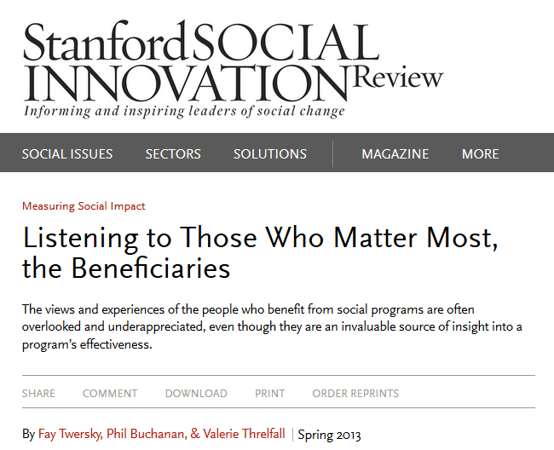
Notes:
https://www.paramedics.org/wp-content/uploads/2017/01/research.jpg
http://darylchow.com/Daryl_Chow/Blog/wordpress/blog/tag/intuition/
https://plato.stanford.edu/entries/scientific-discovery/#DisBetConDisConJus

Slide 13
Tentative problem statements & beneficiaries
Fred: “Homelessness deprives individuals and families of dignity, privacy, and personal security.”
POTENTIAL BENEFICIARIES | THEIR NEEDS
Homeless individuals and families | Shelter, health care, jobs, schools, stability

Slide 14
Tentative problem statements & beneficiaries
Peggy: “Homeless people adversely affect the economy and the quality of life for other individuals in the city.”
POTENTIAL BENEFICIARIES | THEIR NEEDS
Residents, businesses, and communities adversely affected by the homeless. | Personal safety and security, quality of life, cost to taxpayers.

Slide 15
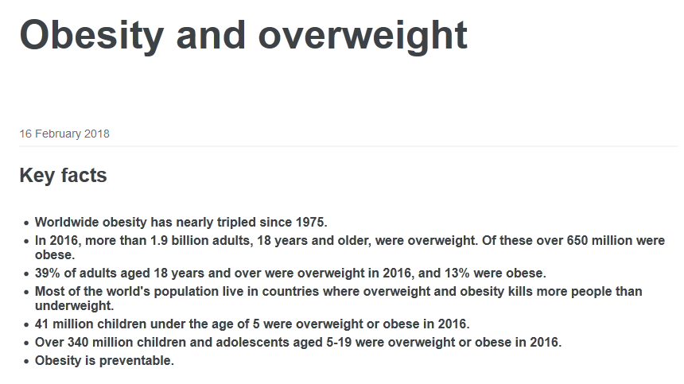
Our Group Problem
Notes:
https://www.who.int/news-room/fact-sheets/detail/obesity-and-overweight

Slide 16
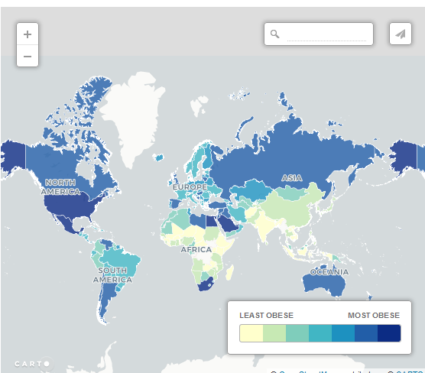
Notes:
https://www.telegraph.co.uk/travel/maps-and-graphics/the-most-obese-fattest-countries-in-the-world/

Slide 17
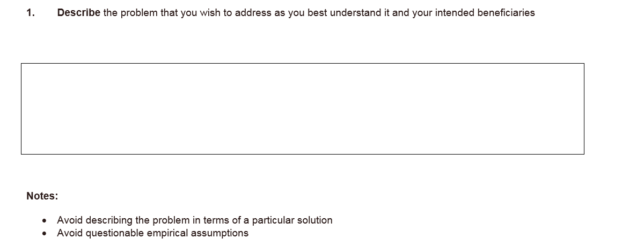
Our Group Problem: Obesity Among Young Adults
Notes:
https://www.google.com/search?q=obese+adults+image&tbm=isch&source=univ&client=firefox-b-1&sa=X&ved=2ahUKEwj5isbT8IzgAhVyKH0KHRo4C_sQsAR6BAgEEAE&biw=1440&bih=784#imgrc=GGROY5trU3efGM:

Slide 18
What are the plausible causes of homelessness?

Slide 19
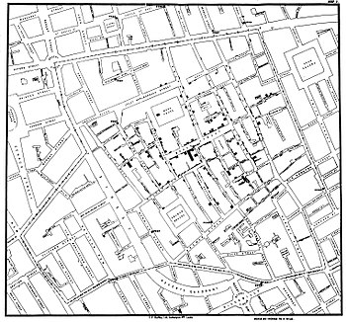
1854 Broad Street cholera outbreak
Why ask about causes early on?
Notes:
https://upload.wikimedia.org/wikipedia/commons/thumb/2/27/Snow-cholera-map-1.jpg/350px-Snow-cholera-map-1.jpg

Slide 20
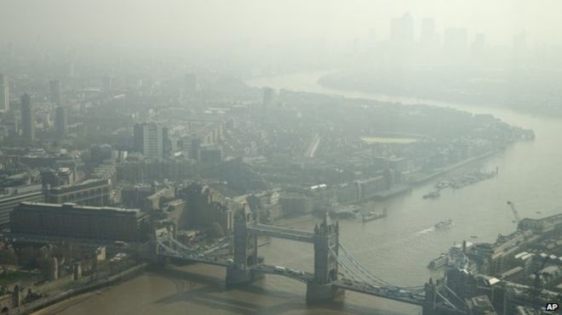
Putative Cause: Miasma
Notes:
https://upload.wikimedia.org/wikipedia/commons/thumb/2/27/Snow-cholera-map-1.jpg/350px-Snow-cholera-map-1.jpg

Slide 21
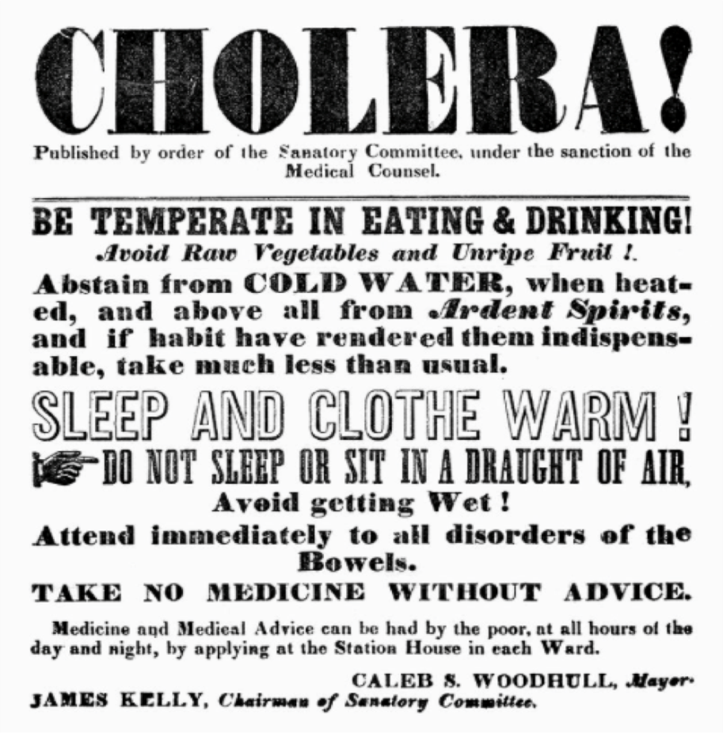
Strategy (Theory of Change) Responsive to Cause

Slide 22
Notes:
https://www.paramedics.org/wp-content/uploads/2017/01/research.jpg
http://darylchow.com/Daryl_Chow/Blog/wordpress/blog/tag/intuition/
https://plato.stanford.edu/entries/scientific-discovery/#DisBetConDisConJus

Slide 23
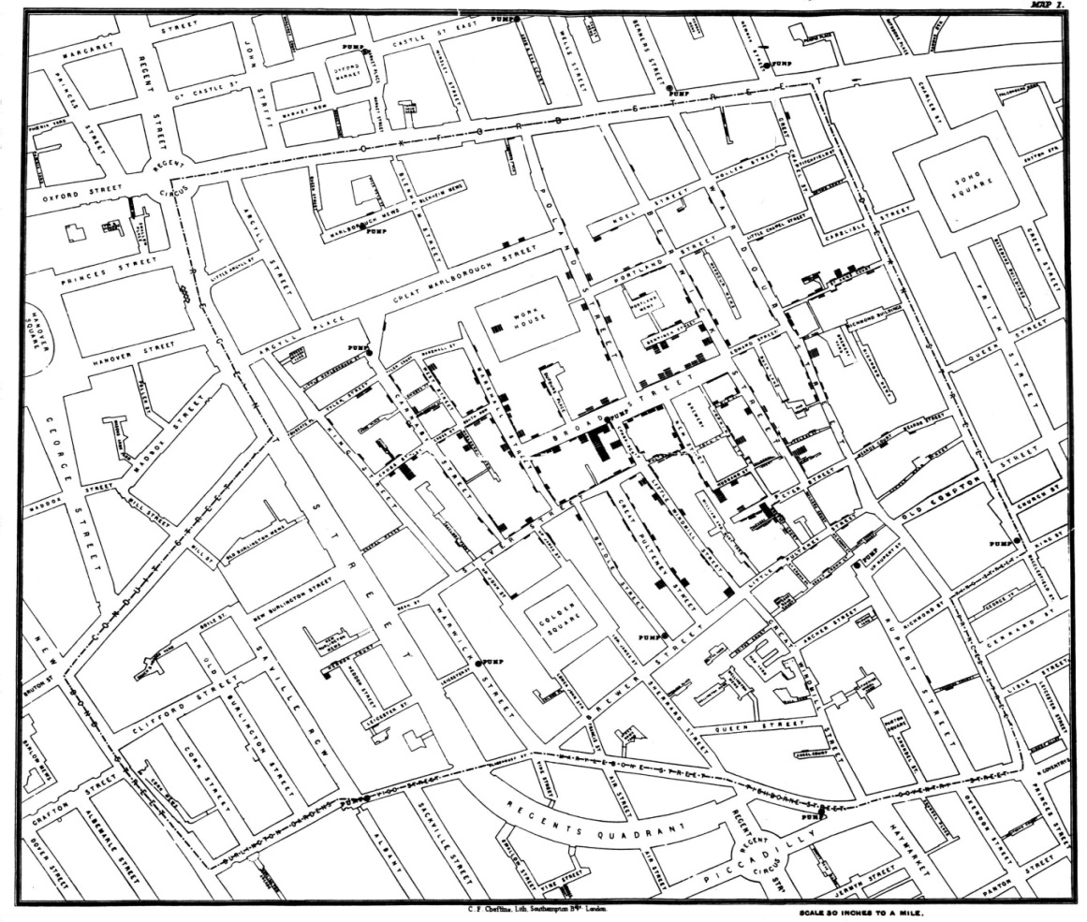
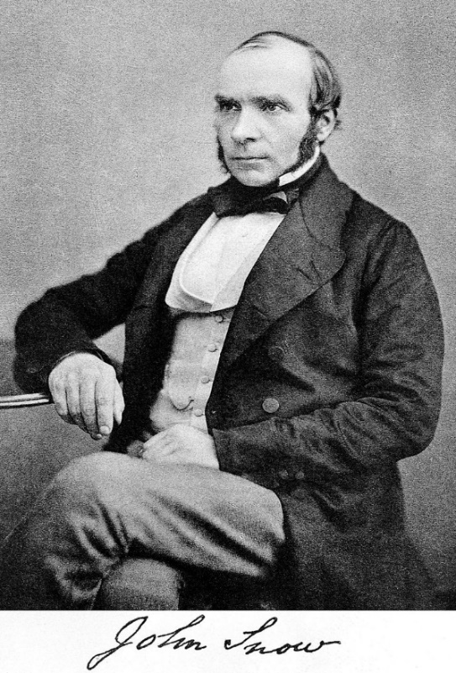
London Cholera Epidemic Redux

Slide 24
Cause
Cholera is an infectious disease … caused by eating food or drinking water contaminated with a bacterium called Vibrio cholera.

Slide 25
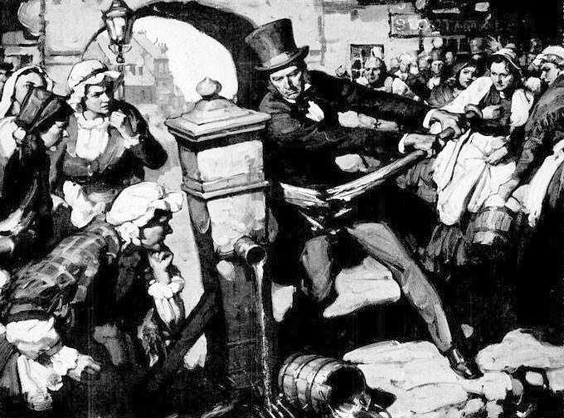
Solution

Slide 26
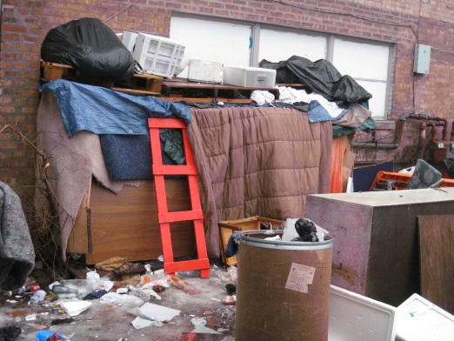
Causes of Homelessness?
Decline in public assistance
Domestic violence
Drug and alcohol related
Lack of affordable housing
Lack of child care
Low wages
Mental illness
Post traumatic stress
Poverty
homelessresourcenetwork.org
Notes:
http://homelessresourcenetwork.org/index.php/homelessness101/homelessness-causes/

Slide 27
Our Group Problem: Obesity Among Young Adults
Causes of obesity among your intended beneficiaries:
*_______________________________________
*_______________________________________
*_______________________________________
*_______________________________________
*_______________________________________

Slide 28
General Approaches to Solving a Problem
Service delivery
Research
Advocacy for policy and systems change

Slide 29
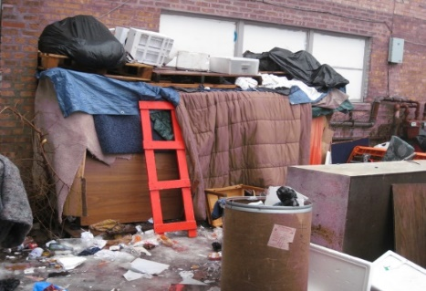
Possible General Approaches to Addressing Homelessness
Provide on-the-street services for the homeless
Service delivery
Accepts status quo
Provide stable housing for those who are homeless
Service delivery
Tries to ameliorate status quo
Help individuals and families at risk avoid actually becoming homeless
Service delivery + supporting eviction defense + policy advocacy
Preventive
Reduce poverty through systems change and policy advocacy
Advocate for major tax code changes, welfare benefits, living wage
Notes:
Assignment 5: Determine Your Approach to Solving the Problem
[SLIDE 12]: Before we turn to solving the problem, let’s get in the right mindset by asking an aspirational question: What would the world look like, ideally, if our problem were solved?
For Fred, the ideal world might be: No one suffers a loss of dignity, privacy, or personal security by virtue of being homeless.
For Peggy, the ideal world might be: Residents do not suffer a loss of quality of life or reduction of property values, nor fear for their safety, and merchants do not suffer lost revenues because of the presence of homeless people.
Both of their aspirations would be met if there were no homeless people in their city.
Of course, it’s seldom possible for a solution to social, environmental, or health problems to actually achieve the ideal. But having this aspiration in mind can help you develop a realistic but ambitious intended outcome and strategy for achieving it, even if it falls far short of your ideal.
Now that we’ve identified some of the major causes of the problem, we can look at a range of potential solutions. As already mentioned in the course, three basic approaches to achieving social change are research, direct services, and advocacy. What would these approaches look like when applied to the problem of homelessness?
The Gordons might reasonably conclude that there’s sufficient knowledge about the causes of homelessness and its solutions that, rather than support further research, they want to take action.
[SLIDE 13] One possibility would be to provide healthcare and other services to homeless people on the street. One advantage is that it offers immediate care. But this particular approach accepts the status quo of people living on the streets – in other words, it is unlikely to change the number of people who are without homes. Although it would begin to address the Fred’s concerns, it wouldn’t address Peggy’s at all.
Another example of direct services would be to provide free housing with support services—what is called permanent supportive housing. Although it is much more expensive than on-the-street care, it has the potential to reduce homelessness—a definite advantage. And it addresses both philanthropists’ concerns.
Yet another approach is to help individuals and families who are at risk of becoming homeless avoid actually becoming homeless. This also involves service delivery in the form of defending families against eviction. Perhaps it also addresses both philanthropists’ concerns. But it imposes a cost on landlords by requiring them to keep on tenants who may not pay their rent on time, and may lead to opposition on the landlords’ part—and perhaps on Peggy’s as well.
A very different approach would be to ameliorate the conditions that lead to homelessness, perhaps by advocating that governments require employers to pay a living wage or that governments provide a basic minimum income. Advocating policy change, if successful, can improve the lives of many individuals, but it can be a risky strategy since policy advocacy often fails to achieve its objectives.
Now please do assignment #5. You'll identify several plausible approaches to solving the problem that you developed in assignment #3.

Slide 30
Criteria for Assessing your Approach to Solving a Problem
How well does it fit your values as a philanthropist, social entrepreneur, or government official?
How likely will it meet beneficiaries’ needs?
How likely is it to succeed?
What resources will it require?
Are they within your capacity acting alone or with others?
Are the benefits worth the costs incurred?

Slide 31
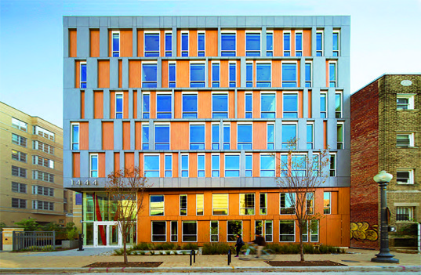
One Approach to Homelessness: Stable Housing
Notes:
Mazara

Slide 32
Consider Several Different General Approaches to Addressing Obesity
Notes:
http://ironpostmedia.com/wp-content/uploads/2016/01/brainstorm.jpg

Slide 33
Consider Several Different Approaches to Addressing Obesity
Approach to solving the problem | Pros/Cons

Slide 34
Intended Outcome Statement for Permanent Supportive Housing
A significant number of the city’s chronically homeless population will be in stable residency. They will also show improvements with respect to:
health
substance abuse
employment
self-reported quality of life

Slide 35
Our Group Problem: Obesity Among Young Adults
What would success be?

Slide 36
Developing a Theory of Change (TOC)
The theory of change is the basic framework underlying a particular strategy.
Begin with intended outcome.
TOC is a causal theory that describes how certain activities will lead to your intended outcome
A program is only as good as the empirical validity of the underlying the theory of change.

Slide 37
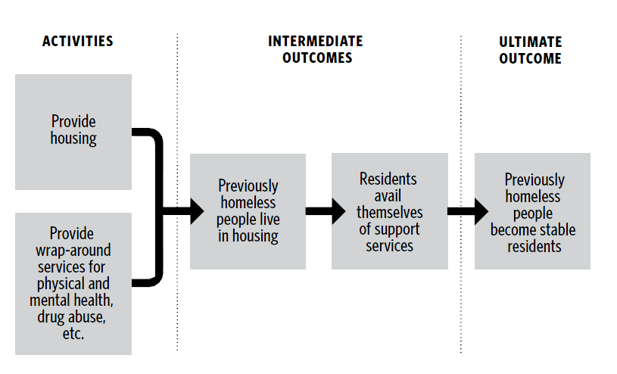
Theory of Change for Addressing Homelessness
Notes:
Assignment 7: Design a Theory of Change
Returning to our philanthropist couple: Fred and Peggy Gordon considered their various choices. After considerable research about approaches that have worked elsewhere, they decide that the most promising approach would involve a “housing-first” permanent supportive housing program.
[SLIDE 15] Let’s take a look at the theory of change chart here:
At the far right side is the ultimate outcome: previously homeless people become stable residents.
[SLIDE 16] At the far left side are the major activities that we perform: providing housing and wrap-around support services
[SLIDE 17] But there are two major steps between these two: To achieve our goal, homeless people must live in the housing and must take advantage of the services offered—these are our major intermediate outcomes.
[SLIDE 18] So the theory of change embodies the basic steps—the chain of causation—leading from the organization’s activities to the ultimate outcome.
But whether one thing leads to another is a question of fact. Simply offering a service does not guarantee that anyone will use it.
Our theory of change raises three questions:
First, will the homeless people move into the housing provided by our organization?
Second, if they move into the housing, will they accept the services offered?
And third, if they move into the housing and accept the services offered, will this be sufficient to keep them in stable housing? Perhaps, for example, some have mental health problems so severe that they’ll soon be back on the street.
[SLIDE 19] So we add questions about these causal links on the next diagram.
How do you establish the validity of these causal links and assess the theory of change before it has even implemented the program? There are two methods.
First, learn about the successes and failures of those who have gone before you. There have been many experiments with permanent supportive housing and many lessons learned. A quick search online will provide a good starting place.
[SLIDE 20] But don’t stop there. Go into the streets and observe and talk to the beneficiaries to learn how attractive the program will be to them. Businesses constantly survey would-be customers to learn whether new products will sell. And we would be wise to do likewise for our target population of homeless people. This is not easily done. If you lack the skills or inclination to do this yourself, retain someone with the requisite skills.
In assignment #7, please sketch a theory of change for achieving the ultimate outcome identified in assignment #6.

Slide 38
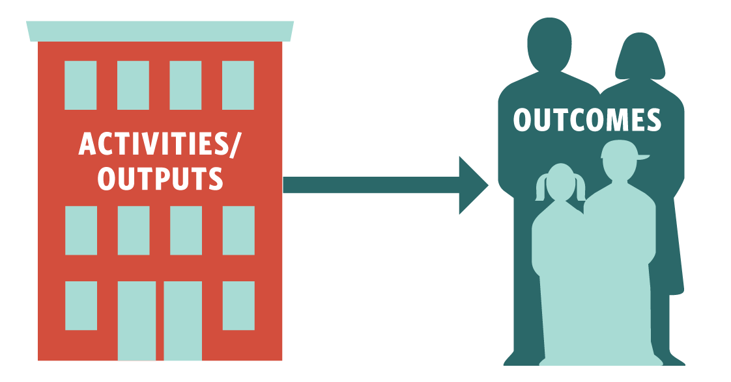

Slide 39
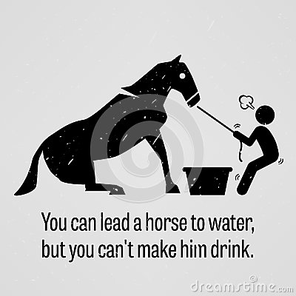
Activities/Outputs (Deliverables) v/s Outcomes?
Activities/Outputs:
Outcomes:

Slide 40
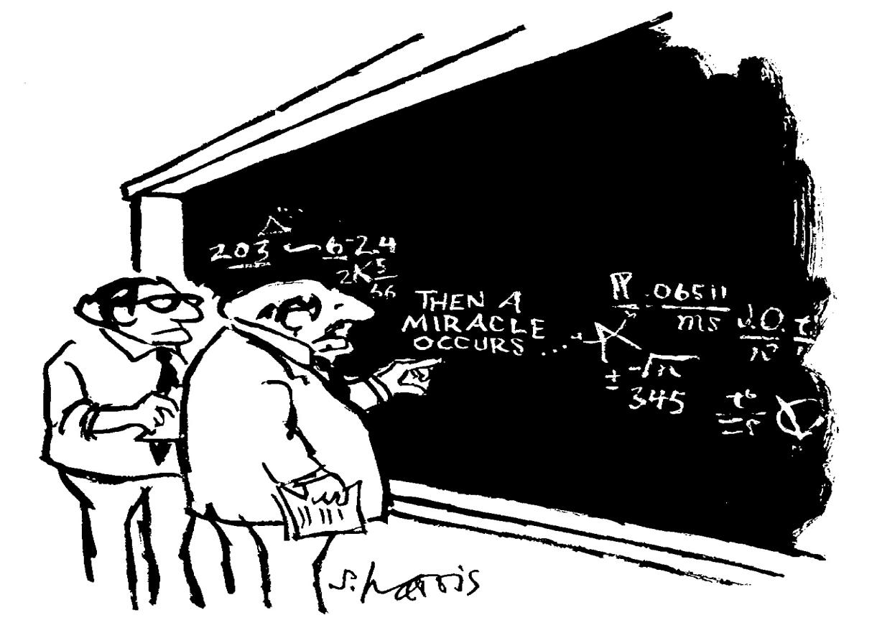
Most Common Error in Theories of Change
“I think you should be more explicit here in step two.”
Notes:
Miracles.
This is actually the default for many philanthropies.
We think it’s a safer bet to rely on science.

Slide 41
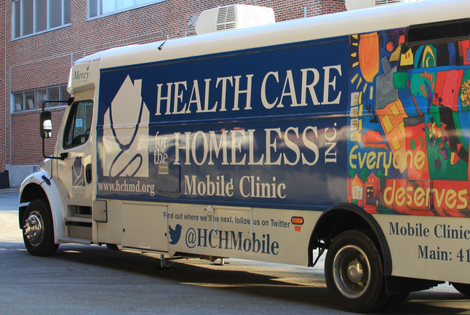
The organization responsible the ultimate outcome may subcontract out the delivery of an intermediate outcome.
Subcontractor is accountable for intermediate outcome, but not for ultimate outcome
Notes:
Assignment 7: Design a Theory of Change
Returning to our philanthropist couple: Fred and Peggy Gordon considered their various choices. After considerable research about approaches that have worked elsewhere, they decide that the most promising approach would involve a “housing-first” permanent supportive housing program.
[SLIDE 15] Let’s take a look at the theory of change chart here:
At the far right side is the ultimate outcome: previously homeless people become stable residents.
[SLIDE 16] At the far left side are the major activities that we perform: providing housing and wrap-around support services
[SLIDE 17] But there are two major steps between these two: To achieve our goal, homeless people must live in the housing and must take advantage of the services offered—these are our major intermediate outcomes.
[SLIDE 18] So the theory of change embodies the basic steps—the chain of causation—leading from the organization’s activities to the ultimate outcome.
But whether one thing leads to another is a question of fact. Simply offering a service does not guarantee that anyone will use it.
Our theory of change raises three questions:
First, will the homeless people move into the housing provided by our organization?
Second, if they move into the housing, will they accept the services offered?
And third, if they move into the housing and accept the services offered, will this be sufficient to keep them in stable housing? Perhaps, for example, some have mental health problems so severe that they’ll soon be back on the street.
[SLIDE 19] So we add questions about these causal links on the next diagram.
How do you establish the validity of these causal links and assess the theory of change before it has even implemented the program? There are two methods.
First, learn about the successes and failures of those who have gone before you. There have been many experiments with permanent supportive housing and many lessons learned. A quick search online will provide a good starting place.
[SLIDE 20] But don’t stop there. Go into the streets and observe and talk to the beneficiaries to learn how attractive the program will be to them. Businesses constantly survey would-be customers to learn whether new products will sell. And we would be wise to do likewise for our target population of homeless people. This is not easily done. If you lack the skills or inclination to do this yourself, retain someone with the requisite skills.
In assignment #7, please sketch a theory of change for achieving the ultimate outcome identified in assignment #6.

Slide 42
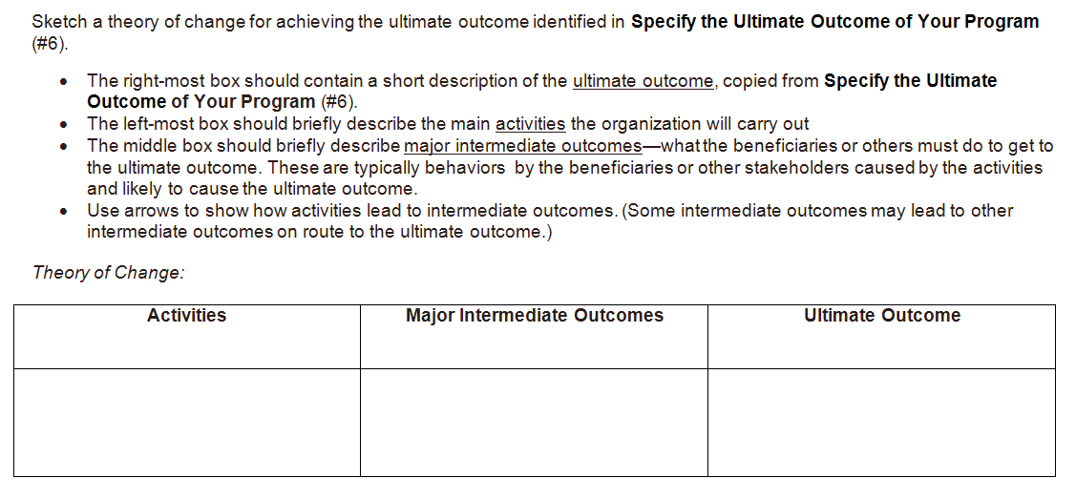
Our Group Problem: Obesity Among Young Adults

Slide 43
Premortem
Look ahead and assume that your strategy has failed and speculate on what may have led to the failure.
Which components of your strategy were most likely to fail?
Unwarranted causal assumptions
Implementation risks
Exogenous factors
What were the barriers to beneficiaries or other stakeholders engaging in behavior necessary to achieve your ultimate outcome?
Notes:
Add slide for notes

Slide 44
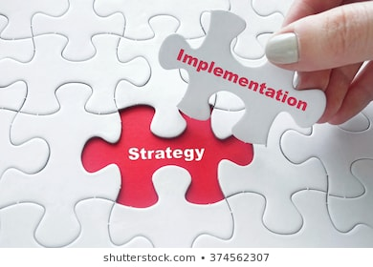
Notes:
https://image.shutterstock.com/image-photo/close-girls-hand-placing-last-260nw-374562307.jpg

Slide 45
Feedback
Evaluation
Monitoring
Fay Twersky
Notes:
Add slide for notes

Slide 46
Feedback
Clients’ own perspectives and opinions
Fay Twersky
Notes:
Define feedback: :
Laser focused on nonprofit customers----you might also say citizens, program participants of all stripes.
Asking for:
Perspectives, preferences, experiences, insights, and ideas for improvement that individuals have about programs, services, products nonprofits are providing
These are people whose voices tend to be least heard
In the social sector, we tend to listen to the experts, researchers, colleagues in the business of providing services
We haven’t done as good a job as we could at lifting up voices of people who should matter most
Is related to equity in a few ways:
Who: people voices least heard
How: do it in a way that is accessible, respectful, inclusive, and also rigorous
Rigor: questions are well crafted, and some source of comparison.
Sometimes we think we need to make a tradeoff between some ways of listening and rigor---but don’t need to!
What: the result, what changed
People are better off in ways they define for themselves.
They share what they think makes for a better experience for them---you listen and respond
So powerful to treat people with dignity

Slide 47
Measures & Goals for Implementation (Monitoring)
ACTIVITIES
What the organization does
OUTPUTS/DELIVERABLES
E.g., Services provided
INTERMEDIATE OUTCOMES
Major actions taken by beneficiaries (or others)
ULTIMATE OUTCOMES
Purchase or rent housing
Recruit and train staff
Recruit chronically homeless people for project
Make housing available
Provide physical health, mental health, drug addiction, employment counseling
Previously homeless people live in the housing
They participate in programs and receive treatment as necessary
Previously homeless people in stable housing
Measures
E.g., How many units available?
E.g., How many people move in and accept services?
E.g., How many people become stable residents?
GOALS
100 units
100 people
70% in 2 years
Notes:
Step in green left to right:
Truly ultimate goal self-sufficiency [is there a better term that truly ultimate? Some people use “impact,” but we reserve that term for beating the counterfactual.]
Ultimate goal for AA’s strategy” get jobs
Beneficiary behavior
Then step in red. I combined barriers. Otherwise too tedious and repetitious.

Slide 48
Chances of Success
Aspiration
With Strategy
Without Strategy
Notes:
Texas sharpshooter: fooling yourself that you had a strategy

Slide 49
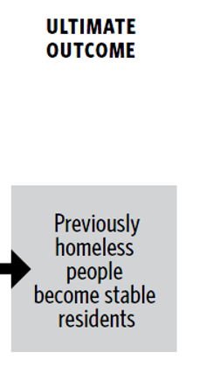
Outcomes vs. Impact (Evaluation)
versus

Slide 50
The Meaning of “Impact”
Let’s suppose that we know that the outcome occurred
And also suppose that the outcome positively correlated with the program. That is, we see an outcome along the lines of our theory of change.
Big question remaining:
Did the program cause the outcome? (Perhaps it would have happened anyway— “counterfactual”)
Notes:
Article implies the presence of a confounding variable

Slide 51
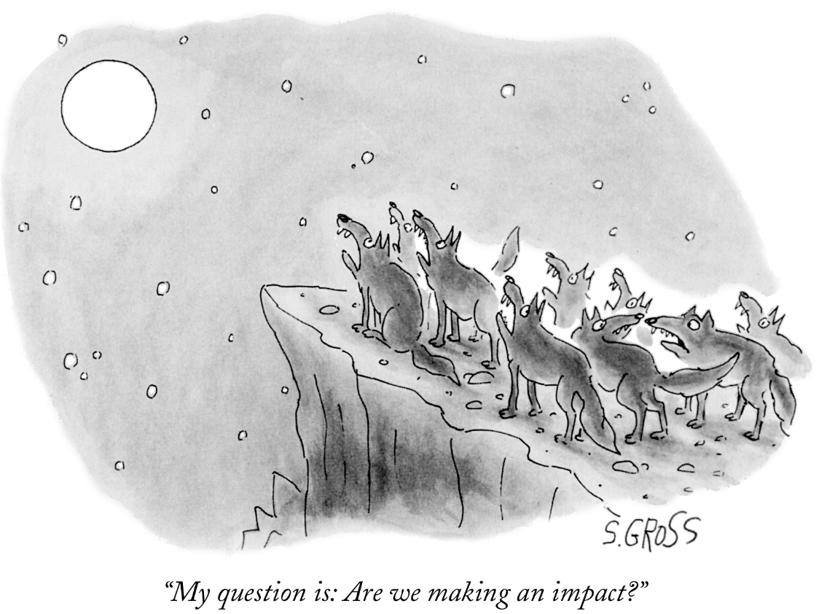
Correlation ≠ Causation (Impact)

Slide 52
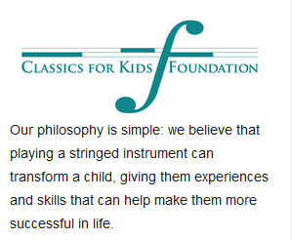
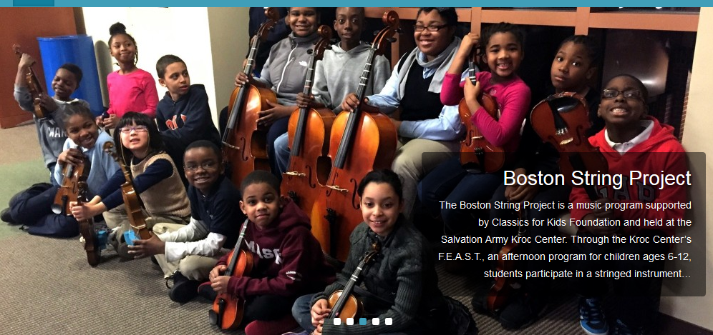
Ultimate Outcome?
Participation in orchestra
Music appreciation
Academic performance

Slide 53
Correlation ≠ Causation
Do students’ participation in a music program improve their academic work?
Notes:
newtelegraphonline.com/wp-content/uploads/2014/04/mosquito-nets.png
http://malariamuseum.com/wp-content/uploads/2010/01/fishing-in-cambodia11.jpg

Slide 54
Correlation ≠ Causation
Or do high-achieving students enroll in music programs?

Slide 55
Counterfactual
They would have excelled academically in any event, even if they had not played in the orchestra.
Causation is “beating” the counterfactual
Notes:
http://www.mamalisa.com/images/the_real_mg/if_wishes_were_horses.gif

Slide 56
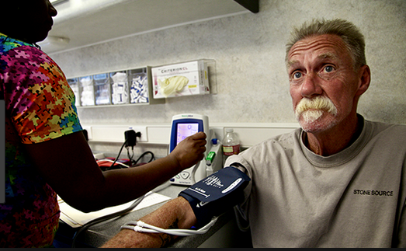
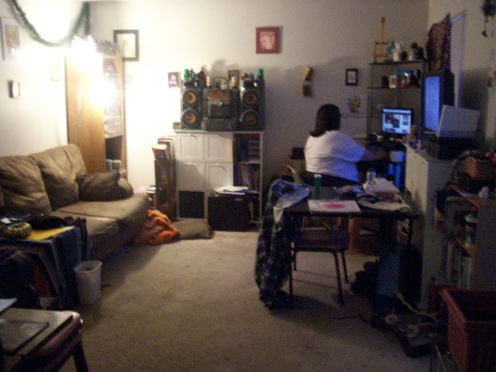
Evaluating One Component of the Intervention
BUT … Did offering housing + wrap-around services cause the outcome—or would the outcome have happened anyway?
Desired outcome happened:
Formerly homeless people in stable residence
Assessing Causation
* Before/after
* Matching
* Randomized controlled trial (RCT)

Slide 57
Before/After
Notes:
https://www.google.com/imgres?imgurl=http://stmedia.startribune.com/images/ows_138178242593180.jpg&imgrefurl=http://www.startribune.com/feeling-sick-know-your-bacteria-vs-virus-facts/288316961/&h=1388&w=1555&tbnid=DEoqCwGYwazndM:&docid=vCQwtwxwQlDDsM&ei=83iyVqfeFIS2jwPmhYDQBQ&tbm=isch&ved=0ahUKEwjno7ywzNzKAhUE22MKHeYCAFoQMwgkKAcwBw
http://www.exhibithealth.com/wp-content/uploads/2013/02/man-feeling-good.jpg

Slide 58
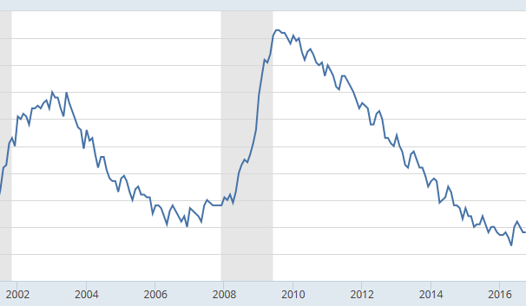
Before/After
Compare all participants who entered the program with those who ended up better off.
Suppose at the end of the evaluation period:
100 | participants (homeless people, with poor health and other metrics)
40 | Still homeless
60 | In stable housing
60% | Success rate
But maybe during this period something unrelated to the program supervened to improve the lives of homeless people in the city, e.g.
Housing costs decreased
Employment opportunities increased

Slide 59
1994. William Bratton becomes NYPD Commissioner, adopts Broken Windows approach to policing.

Slide 60
Before-After
Bratton Starts as Commissioner

Slide 61
Before-After: More Data
Bratton Starts as Commissioner

Slide 62
If you could get more information, what would it be?

Slide 63
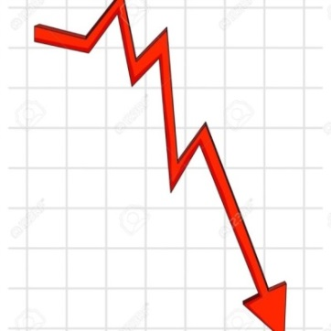
New York Crime Rates Comparison With Other Cities
New York
Detroit
Question for matching: How similar with respects to other factors that may affect crime rates?

Slide 64
Other Cities
From Levitt 2004

Slide 65
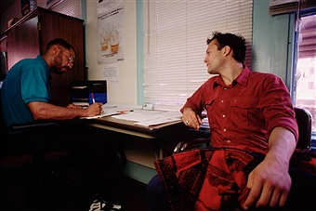
Matching to Evaluate Effect of Wrap-Around Services
Treatment group
100 permanent supportive housing units with wrap-around support services.
Control/Comparison group
100 permanent housing units but no wrap-around support services.
When someone is eligible for housing, the program administrator assigns them to one or the other housing complex.
Problems:
Don’t know what criteria the housing administrator used.
Many differences among homeless individuals.
How do you ensure that the matching group are sufficiently similar to those who received permanent supportive housing services?
Notes:
http://cache4.asset-cache.net/xr/526763192.jpg?v=1&c=IWSAsset&k=3&d=77BFBA49EF878921CC759DF4EBAC47D0EFBA579BBD916D850771093EFA8DF919A4D52CC52F248300A55A1E4F32AD3138

Slide 66
Randomization
Program administrator flips a coin to determine if the applicant gets just housing or supportive housing.
What problems does this solve?
*Eliminates “selection bias”
*Don’t need to match

Slide 67
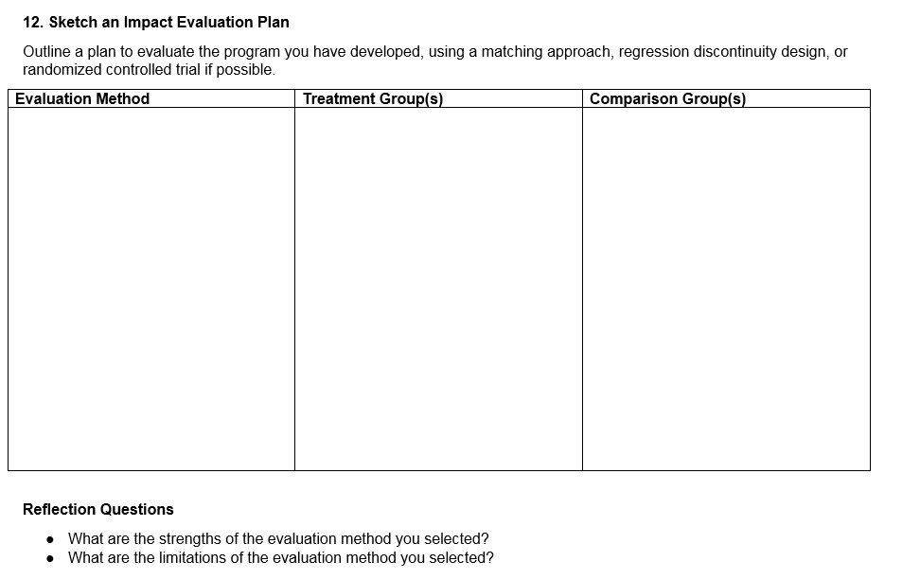
Evaluation Options
* Before/after
* Matching
* Randomized controlled trial (RCT)

Slide 68
SMART Progress Metrics and Targets
S = Specific: clear and focused to avoid misinterpretation.
M = Measurable: can be quantified and compared to other data.
A = Attainable: achievable, reasonable, and credible.
R = Realistic: fits into the organization's constraints.
T = Timely: doable within the time frame given.

Slide 69
Matching + Difference in Differences
1. Establish baselines for each group by assessing their scores on the relevant metrics (poverty levels, family structure) before the program.
2. Calculate changes in each group at the end of the evaluation period
For each group, subtract the percentage showing improvements in these characteristics from baseline.
Thus you have a before/after difference for each group
3. Subtract the difference in the treatment group from the difference in the comparison group. This is the difference of the two differences (where the technique gets its name).
Advantages: Reduces effects of factors that don’t change over time (intelligence, family health history) that affect all people who defecate in the open.
Limitations: You don’t know if there were salient differences between the two groups.

Slide 70
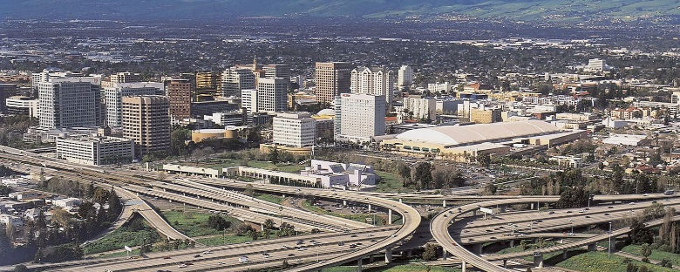
Scaling and Replicating Permanent Supportive Housing (PSH)
One year after it was implemented, the city’s permanent supportive housing program has been a great success—as evaluated by a good randomized controlled experiment.
The county government is now considering implementing the program in rural parts of the county, whose main industry is agriculture, and which has a substantial number of migrant workers.

Slide 71
Evaluation is Retrospective
Notes:
http://mindfulbalance.files.wordpress.com/2012/01/looking-backwards.jpg

Slide 72
Generalizability (External Validity) Problem
Predicting impact of program—prospective
“Same” population in the future. The program was successful in 2018, but will it succeed in 2020?
“Different populations. The program was successful in the city, but will it succeed in rural parts of the county?
Notes:
https://www.google.com/url?sa=i&rct=j&q=&esrc=s&source=images&cd=&cad=rja&uact=8&ved=&url=http%3A%2F%2Fwww.patheos.com%2Fblogs%2Fgetreligion%2F2014%2F03%2Fboo-no-ghosts-in-wsj-coverage-of-rural-urban-divide%2F&psig=AFQjCNFLIT_WvPNo4tMBck3_7eAXyKpbaQ&ust=1460741919366434http://www.nimbleuser.com/media/189943/2015-2016_535x321.jpg
https://s-media-cache-ak0.pinimg.com/736x/1a/70/d0/1a70d0af0ae64a6d22eb5886786a9abc.jpg

Slide 73
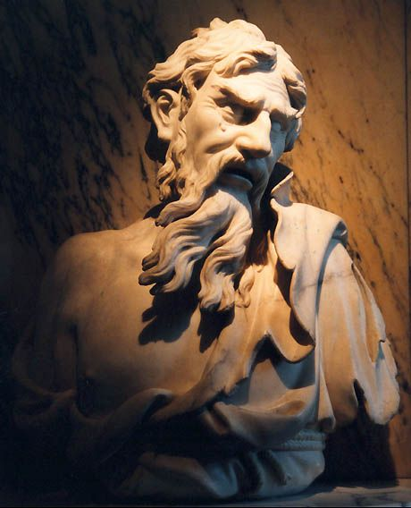
External Validity/Generalizability Problem
δὶς ἐς τὸν αὐτὸν ποταμὸν οὐκ ἂν ἐμβαίης.
Notes:
http://www.optionality.net/heraclitus/heraclitus2.jpg

Slide 74
External Validity/Generalizability Problem
Which of Our Impact Evaluation Techniques Does Generalizing to a New Situation Most Resemble?
* Before/after
* Matching
* Randomized controlled trial (RCT)

Slide 75
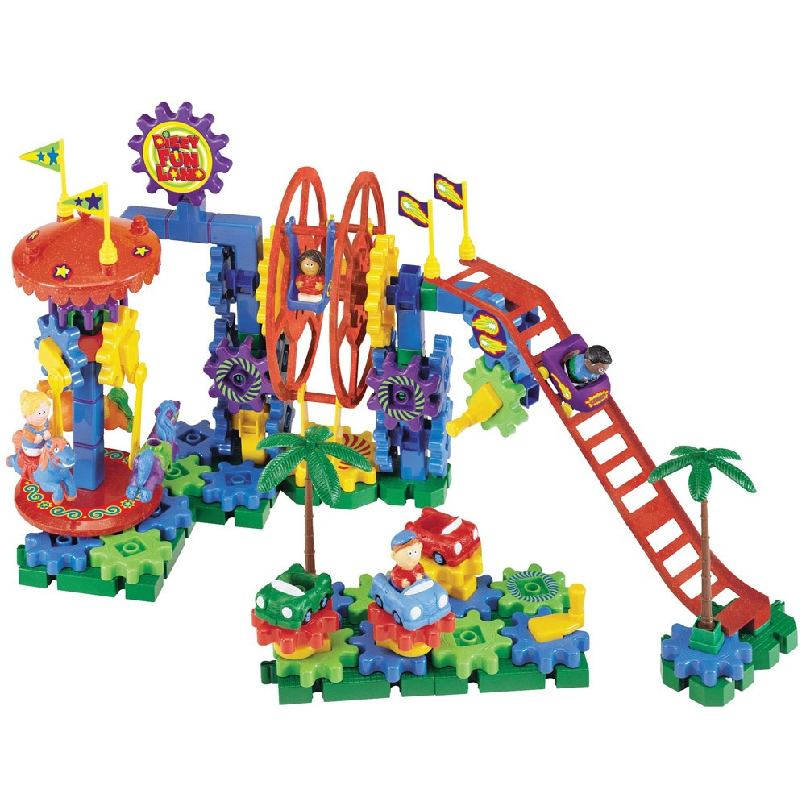
Mechanism
Notes:
https://www.google.com/search?client=firefox-b-1-d&tbm=isch&q=gears+image&chips=q:gears+image,g_1:toy:qGOrHtlUdt0%3D&usg=AI4_-kRWgUGu7YUh7_swNyvXlo7nhE3dZg&sa=X&ved=0ahUKEwjO0ObW9tXhAhXpsFQKHVOlCTcQ4lYIOSgJ&biw=1440&bih=784&dpr=1.33#imgdii=5B1Tlt6vuafRgM:&imgrc=kQRuzn6OIY-hyM:

Slide 76
Thank you!

Slide 77
Theory of Change Worksheet
Sketch a theory of change for achieving the ultimate outcome identified in “Specify the Ultimate Outcome of Your Program.”
The right-most box should contain a short description of the ultimate outcome, copied from “Specify the Ultimate Outcome of Your Program.”
The left-most box should briefly describe the main activities the organization will carry out.
The middle box should briefly describe the major intermediate outcome—what the beneficiaries or others must do to get to the ultimate outcome. These are typically behaviors by the beneficiaries or other stakeholders caused by the activities and likely to cause the ultimate outcome.
Use arrows to show how activities lead to intermediate outcomes. (Some intermediate outcomes may lead to other intermediate outcomes on route to the ultimate outcome.)
Activities | Major Intermediate Outcomes | Ultimate Outcome
Notes:
https://www.google.com/search?client=firefox-b-1-d&tbm=isch&q=gears+image&chips=q:gears+image,g_1:toy:qGOrHtlUdt0%3D&usg=AI4_-kRWgUGu7YUh7_swNyvXlo7nhE3dZg&sa=X&ved=0ahUKEwjO0ObW9tXhAhXpsFQKHVOlCTcQ4lYIOSgJ&biw=1440&bih=784&dpr=1.33#imgdii=5B1Tlt6vuafRgM:&imgrc=kQRuzn6OIY-hyM:

