Slide 1
Pragmatic Optimism:
Fighting Poverty with Hearts and Minds
Dean Karlan
Northwestern University & Innovations for Poverty Action

Slide 2
Types of Nonprofits
Club
  Donor “consumes” the nonprofit
  Donor experiences the nonprofit’s services and judges quality
Service Delivery
  Meaningful metrics viable to quantify (even if qualitative)
  Attribution often viable
Research & Advocacy
  Meaningful metrics hard to quantify
  Attribution often not viable without mere “stories”
Notes:
"club" nonprofits - donor "consumes" the nonprofit, gets to experience it themselves, judges based on this
Walk through the three categories and then ask students to brainstorm

Slide 3
Two Parts
The CART Principles from the Goldilocks Challenge
  Credit, Actionable, Responsible, Transportable
Example
  Microcredit
  Graduation
  International Care Ministries (ICM) in the Philippines

Slide 4
The Role of Data
Look forward!
Either:
“Does it work?” to know whether to scale & replicate
OR
“How to make it work best?” to manage and improve

Slide 5


IPA’s Right-Fit Evidence Unit
Helping organizations make learning-oriented M&E a reality

Slide 6




The CART principles
Credible
Actionable
Collect high quality data and analyze the data accurately
Collect data that can help you make choices, and commit to act on it
Responsible
Transportable
Ensure the benefits of data collection outweighs the cost
Collect data that generate knowledge for other programs

Slide 7
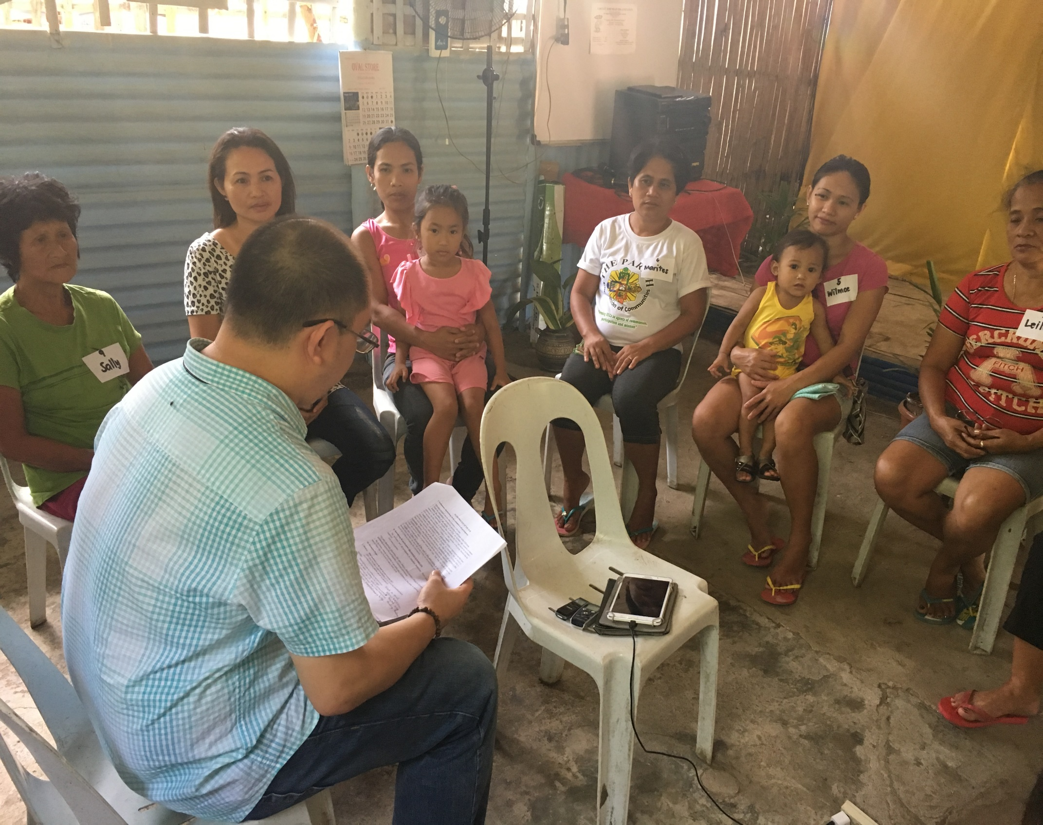
Data Quality:
Listen to constituents!
Pilot:
  What matters to them?
  What is success?
  Does this question make sense to them?
  Does this question make sense in their context?
  Does this question generate any variation?
CRITICAL for quality data

Slide 8
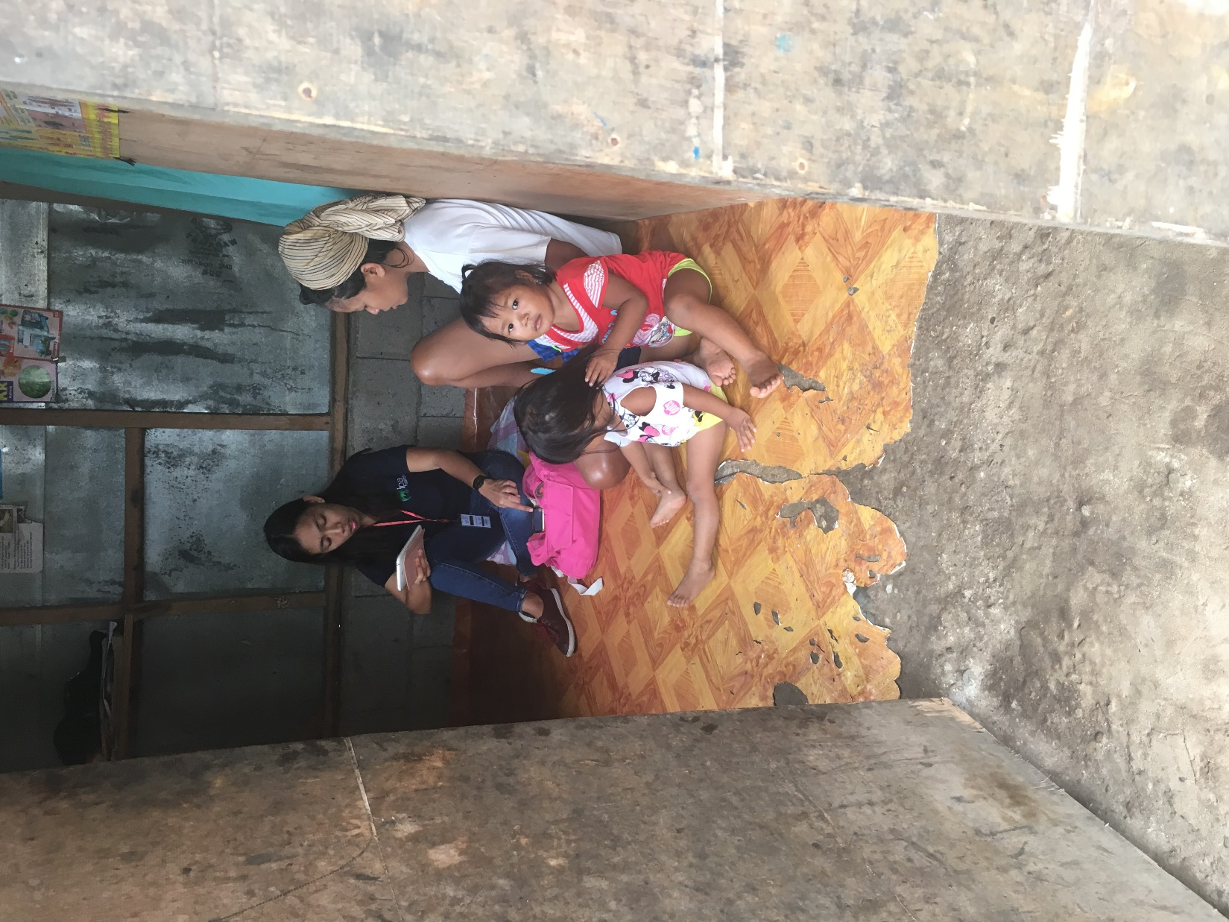
Quality Data:
Measurement Process
Pilot: listen to a few people
Survey: listen to a ton of people!
Surveyors:
  Qualities: knowledge of local context, empathetic, respectful, ethical, committed
  Training: knowledge of the questions, context of the evaluation, and roles in the team
  Career: Can move on to become team leaders, field coordinators, field managers or research associates.
  Feedback critical to improve the survey, catch errors.
  Regular and direct contact with the person managing the data collection
  Trust but verify: audit subset

Slide 9
Credible Analysis:
What do we learn from overhead ratios?
Overhead ratio: the percentage of expenses devoted to management and fundraising costs.
Q: What percentage of nonprofits spend more on administrative costs than program costs (i.e., have an overhead ratio greater than 50%)?
A: 2.5% of nonprofits with more than $1 million in revenue; that’s almost 55,000 organizations accounting for 94% of donations to public charities.
Notes:
Source: Karlan, Dean. “Here’s how to determine if that charity is worth your dollars.” Op-ed, Los Angeles Times, December 17, 2014.

Slide 10
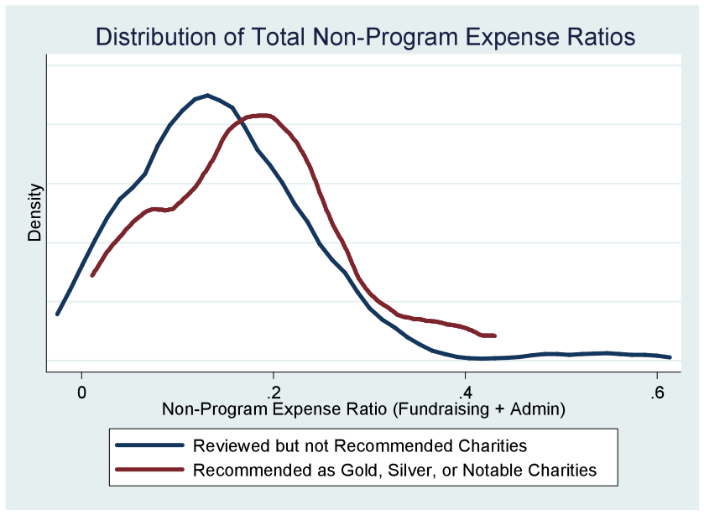
Do high-quality charities have low overhead?
“Why Ranking Charities by Administrative Expenses is a Bad Idea.” Dean Karlan, Freakonomics post

Slide 11


Which would you buy in order to increase test scores?
$100
Merit-Based Scholarships for Girls
$100
Reassigning students to classes based on learning level
Notes:
But sometimes the decision is not so easy. Let’s say you would like to donate 100 dollars to a program that aims to help improve learning (by way of increased test score performance) for school-age children in lower-income countries.
Would you give your money to a program that offers merit-based scholarships for girls, which could increase girls’ incentives to attend school and learn? Or to a program that reassigns students to classes based on learning level, because allowing teachers to better tailor their materials to the level of their students could improve learning in the classroom?
In that case, unlike the oranges, you cannot see what you are actually buying – improvement in test scores. What do you think is the ration here, 1 to 4, more, less?

Slide 12
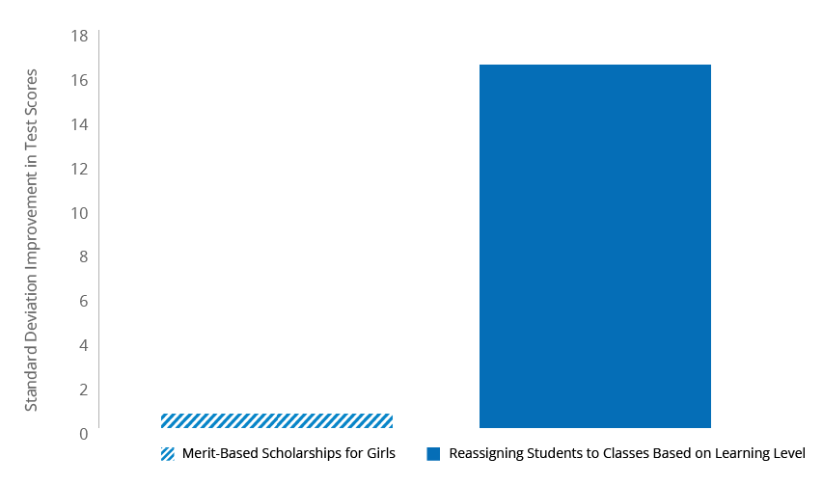
Improved test scores for $100
SOURCE: Poverty Action Lab.
Notes:
And yet it really matters.
This graph shows you the standard deviation improvement in test scores you can get for 100 dollars.
It turns out that both of these interventions work, but with reassigning students based on their learning level, you get significantly more improvement in test scores... this approach is the most consistently effective, and is also very cost-effective.
I wont speak any longer about these programs, but there are really two take aways:
There can be a lot of variation in the impact you get for your dollar, in other words return on Investment (ROI)
It is most of the time not obvious which ideas will be most cost-effective. This requires precise measures of impact and costs.

Slide 13

Which job training program would you buy?
$100
Cost per participant
90% of participants are employed
1 month after the training
$100
Cost per participant
60% of participants are employed
1 month after the training
Notes:
But sometimes the decision is not so easy. Let’s say you would like to donate 100 dollars to a program that aims to help improve learning (by way of increased test score performance) for school-age children in lower-income countries.
Would you give your money to a program that offers merit-based scholarships for girls, which could increase girls’ incentives to attend school and learn? Or to a program that reassigns students to classes based on learning level, because allowing teachers to better tailor their materials to the level of their students could improve learning in the classroom?
In that case, unlike the oranges, you cannot see what you are actually buying – improvement in test scores. What do you think is the ration here, 1 to 4, more, less?

Slide 14
Credible:
What is impact?
  Outcome after program
Observed outcome
Same outcomes, same timing, but had they not participated in the program
Counterfactual
IMPACT

Slide 15
Credible
Attribution Challenges
Outside factors
  Weather
  Macro conditions
  Other policy changes
  Etc…
Selection factors
  Who participates? Does joining indicate upward trajectory?
  Who is chosen? Does being chosen indicate upward trajectory?

Slide 16
Credible Analysis:
Ask program participants to evaluate effectiveness?

Slide 17
Are program participants good evaluators?
National Job Training program
Targeted to serve economically disadvantaged adults and youths
Findings:
  Participant evaluations are unrelated to the randomized trial impact estimates
  Participant evaluations correlated with:
    Service intensity, outcome levels, and before-after outcome differences
Source: Smith, Jeffrey, Alexander Whalley and Nathaniel Wilcox. 2014.
Notes:
National JTPA Study (NJS): https://www.upjohn.org/data-tools/employment-research-data-center/national-jtpa-study

Slide 18
Choose a program to invest in
National Guard Youth Challenge (DoD)
  17 month program for men and women ages 16 to 18, who have dropped out of (or been expelled from) school, are unemployed, drug-free, and not heavily involved with the justice system
  Two-week orientation and assessment period; a 20-week Residential Phase; and a one-year Postresidential Phase with a mentoring program
  Three years after the program, the treatment group was significantly more likely to be employed (3.9*) and was earning more than the control group (2,266 ***) at the time of the survey.
  Employed T = 88.4% C = 84.5% N = 1173
  Earnings T = 13515 C = 11248
Notes:
National JTPA Study (NJS): https://www.upjohn.org/data-tools/employment-research-data-center/national-jtpa-study

Slide 19
Choose a program to invest in
Connecticut’s Jobs First Evaluation (DoL)
  Ongoing program for single parents with children aged 37 months to 10 years old receiving income support from the state of Connecticut.
  Program provides employment assessments, assistance in developing employment plans, and case manager support to all participants.
  18 months after entering the program, the group employment assistance and income support through Jobs First were no more likely to be working at the time of surveying than the control group (.29%), but was more likely to have worked at some point over the past 18 months (.64%*)
  Currently Employed – Before: T = 0% C = 0% - After T = 56.23% C = 48.92%
    Unemployment was a requirement for entry – control group received the old version of the program run by the state of CT (ADCP)
  Employed at any point during the 18 months – T = 80.43% C = 68.49%
Notes:
National JTPA Study (NJS): https://www.upjohn.org/data-tools/employment-research-data-center/national-jtpa-study

Slide 20
Choose a program to invest in
National Job Corps Study and Longer-Term Follow-Up (DoL)
  Nationwide education and job training program serving disadvantaged youth between the ages of 16 and 24.
  Program participants receive vocational training, health care supplements, and other counseling support focusing on social skills, health awareness, and recreational outlets.
  4 years after entering the program, treatment participants were more likely to be actively employed at the time of follow-up (2.4%***) and were also more like to be working for employers that provide health insurance (3.0%*) and retirement benefits (4.6%***)
  Employed at 4 year follow-up T= 71.1% C = 68.7% N = 11313
  Health Insurance T= 57.4% C = 54.3%
  Retirement T = 48.3% C = 43.7%
Notes:
National JTPA Study (NJS): https://www.upjohn.org/data-tools/employment-research-data-center/national-jtpa-study

Slide 21
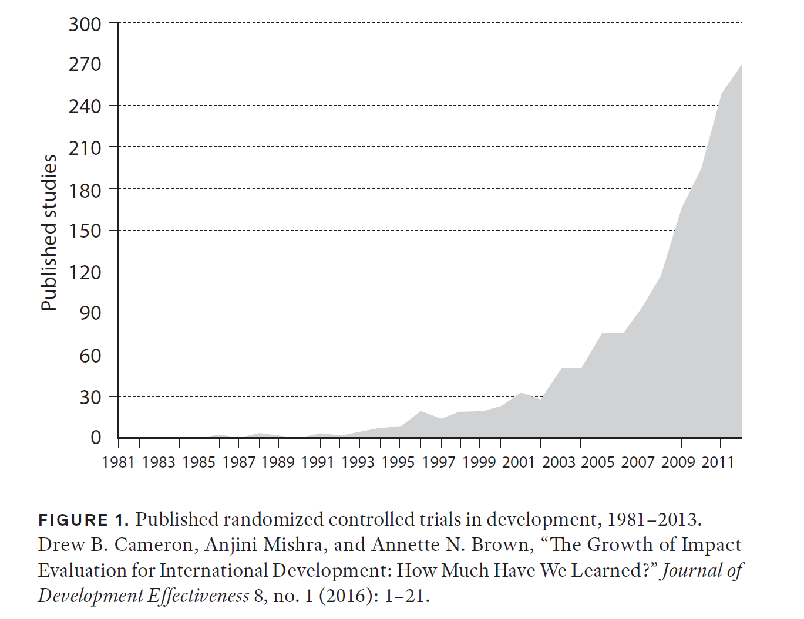
Randomized Trials in Development Economics
Notes:
This graph shows the huge growth in impact evaluations of international development programs. Clearly there is a HUGE growth in knowledge and evidence of impact.

Slide 22
Microcredit
Small loans to the poor
  Typically, but not necessarily:
    Target micro-entrepreneurs
    Short-term (4-12 months)
    Women
  Amounts typically start at $50-$500
  Historically, non-profits were Lenders
  Now, trend towards commercialized Lenders

Slide 23
Microcredit
What happens to average income of participants?
1. Up
2. No statistically significant change
3. Down

Slide 24


Was microfinance an over-hyped solution?
“Most of the poor … are in deep trouble due to these loans… Poor people are committing suicides because of…pressure for repayment.”
Andra Bhoomi, 9/4/06
“Micro-credit has been changing people's lives and revitalizing Communities”
UN, 2005, Year of micro-credit
Notes:
Without it, the risk is that we are left to our beliefs, our hopes or ideologies. (Use J-PAL 3 I slide?)
For example, take microcredit. There is a tendency in the development sector to find the silver bullet, and microcredit was long believed to be one. There were numerous claims like this one, in 2005.
On the other hand, around the same time, MC was claimed by others to..

Slide 25
Impact?
Somewhat.
Outcome | Bosnia & Herzegovina | Ethiopia | India | Mexico | Mongolia | Morocco | Philippines
Business ownership |  | - | - | - |  | - | -
Business revenue | - | - | - |  | - |  | -
Business inventory/assets |  | No data |  | No data |  |  | -
Business investment/costs | - | - |  |  | No data
Business profit | - | - | - | - | - |  | -
Household income | - | - | - | - | - | - | -
Household spending/ consumption | - |  | - |  |  | - | -
Social well-being | - | - | - |  | - | -
Findings from impact evaluations of microfinance programs, by country.
Notes:
Source: J-PAL

Slide 26
The Graduation Model
The poverty trap: a self-reinforcing mechanism that makes it very difficult for people to escape poverty.
What are the market failures?
  Financial: microcredit, savings, risk
  Information
  Markets
  Behavioral
  Health and education
Can a “big push” program address these challenges simultaneously?

Slide 27

A multi-faceted intervention
Randomized evaluations tested the graduation model in Ethiopia, Ghana, Honduras, India, Pakistan, and Peru.
Households randomly assigned to participate in the program received multiple types of support over a two-year period.
Follow-up 2-10 years later
Notes:
Before the Graduation Program begins, the treatment and control groups look the same. We then begin the program, and the asset transfer adds a bit of wealth to the treatment group. Then we add in the health component, and see another increase. Similarly, when we add the savings and training components, the treatment group continues to increase its wealth and rise out of poverty.
This is what the first phase of the program has been able to do: it tests to see whether the whole package works. So far, it works in most of our sites and the results are very promising.
Source: Innovations for Poverty Action (IPA)

Slide 28

Eight Countries
Bangladesh
Pakistan
Honduras
Yemen
India
Ghana
Ethiopia
Peru
Notes:
Adaptation and replication of the graduation approach is sponsored by CGAP and the Ford Foundation, and we are carrying out randomized evaluations in 7 sites.
One question you might be asking is why is this study being conducted in so many places? Replication is important for both theoretical and practical reasons. From a theoretical standpoint, results are more robust if they are upheld in different contexts and with different implementing partners. Furthermore, testing this approach in a variety of contexts can help us understand the mechanisms that drive the graduation process and what components are salient across countries. This is why it is also of practical importance: if we find something that works, then we should see if it works in different settings and adapt it to different settings in order to effectively combat poverty.
Finally, from a policy-standpoint, governments and international organizations are more likely to adopt policies that are supported by robust evidence taken from a variety of contexts, or from a context similar to one’s home country.

Slide 29
Asset Index
Total asset value
Pooled endline 1: $599 (control mean $2619)
Pooled endline 2: $533 (control mean $2300)
Notes:
Total asset value (drawn from data from Peru, Pakistan, Honduras, Ethiopia – effect size is from whole sample’s asset index)
(2014 US$ PPP)
Pooled EL 1 – control 2619; treatment 3218 (23% increase)
Pooled EL 2 – control 2726; treatment 3018 (11% increase)

Slide 30
Mental Health
Self-reported life satisfaction (1-5 scale)
Pooled endline 1: 0.11 points (control mean 2.99)
Pooled endline 2: 0.08 points (control mean 3.13)
Notes:
Self-reported satisfaction with life (1-5 scale)
Pooled EL 1 – control 2.99; treatment 3.10 (4% increase)
Pooled EL 2 – control 3.13; treatment 3.21 (2% increase)

Slide 31
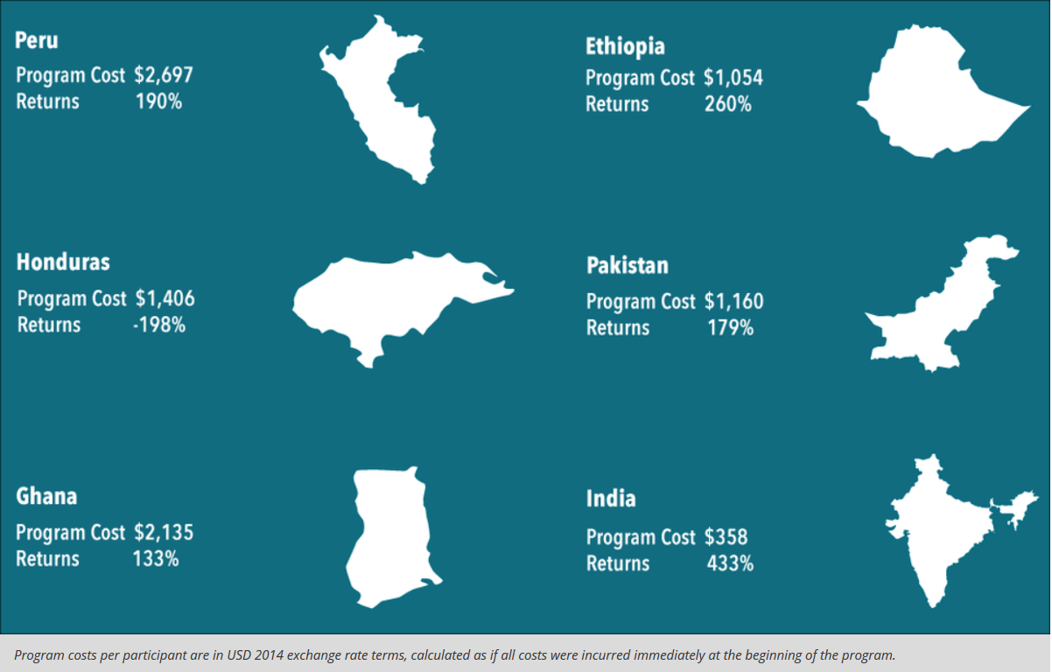
A cost-effective intervention for helping the ultra-poor
Ex: for every dollar spent on the program in India, ultra-poor households had $4.33 in long-term benefits.
Notes:
The program was also cost effective, with positive returns in five of six countries, ranging from 133 percent in Ghana to 433 percent in India.
In other words, for every dollar spent on the program in India, ultra-poor households had $4.33 in long-term benefits.
Source: Innovations for Poverty Action (IPA)

Slide 32
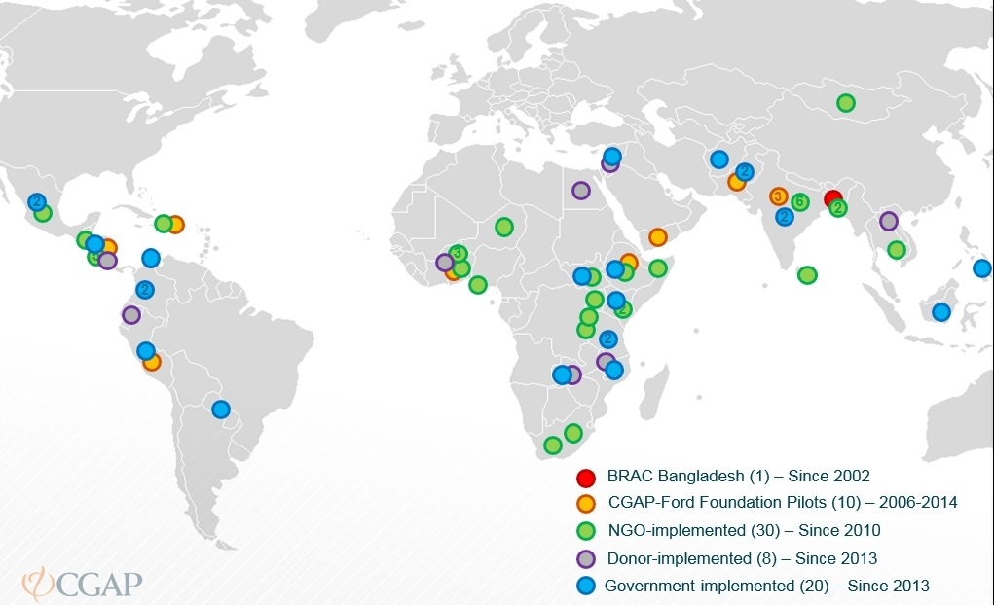
Leveraging evidence: Expanded to 58 projects in 37 countries
Notes:
Upshot here: studies like this can be powerful in helping show what works, and in helping ensure what works is implemented by governments at scale. Great use of USG funds to create this kind of impact – Ethiopia (where USAID partnered on the study) is integrating into its social safety net program which will reach 3 million people in that country alone. Anne thinks you could play a little bit up the "hand up" part of the program and say something like there will probably always be a need for gov'ts to subsidize these kinds of programs for the ultra poor, but this model and the power of the evaluation shows that it can be something gov'ts can then do themselves.

Slide 33
New studies to work on Hope and Aspiration…
Cognitive Behavioral Therapy?
Religion?

Slide 34

Positive correlations with religiosity
Diligence
Thriftiness
Trust
Cooperation
Physical health
Lack of criminality
Avoidance of substance abuse
Income
Educational attainment
Hard to infer:

Slide 35
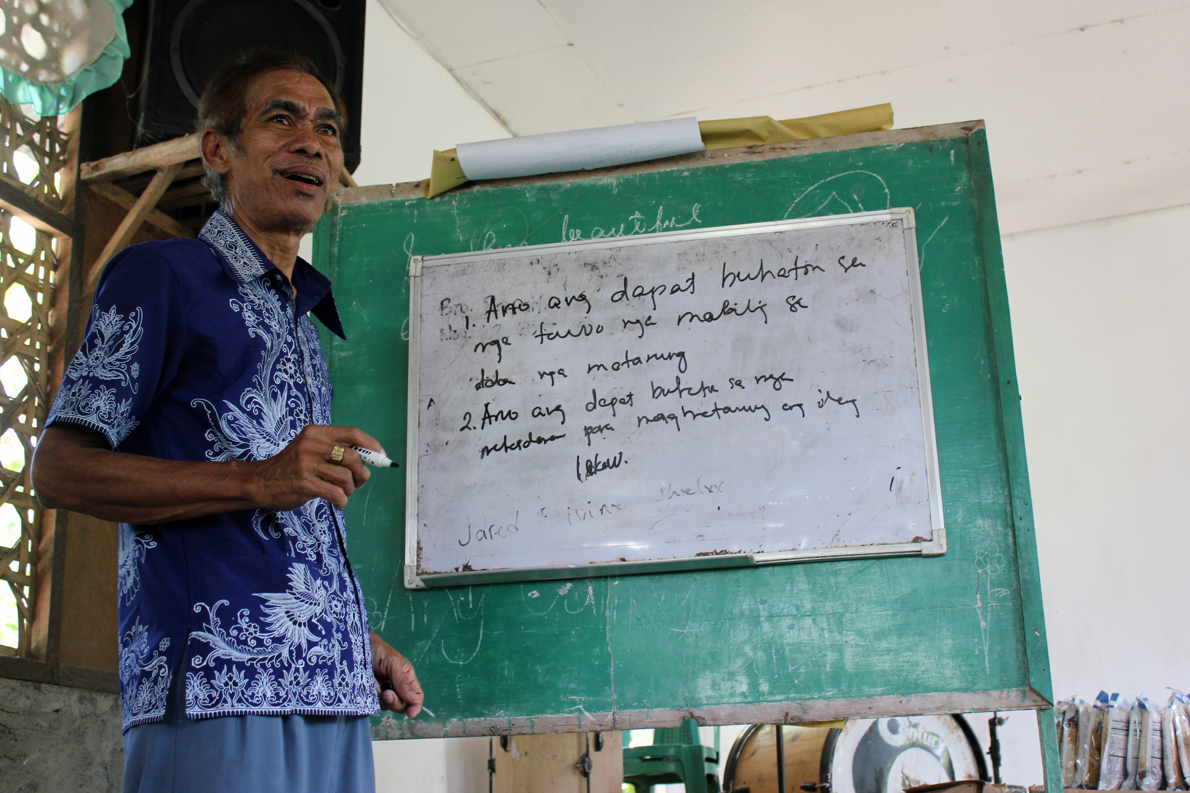
International Care Ministries (ICM)
NGO Partner
Faith based Protestant organization
Social services for ultra-poor households in the Philippines
Commitment to data evaluation
Program evaluated: Transform

Slide 36


Slide 37
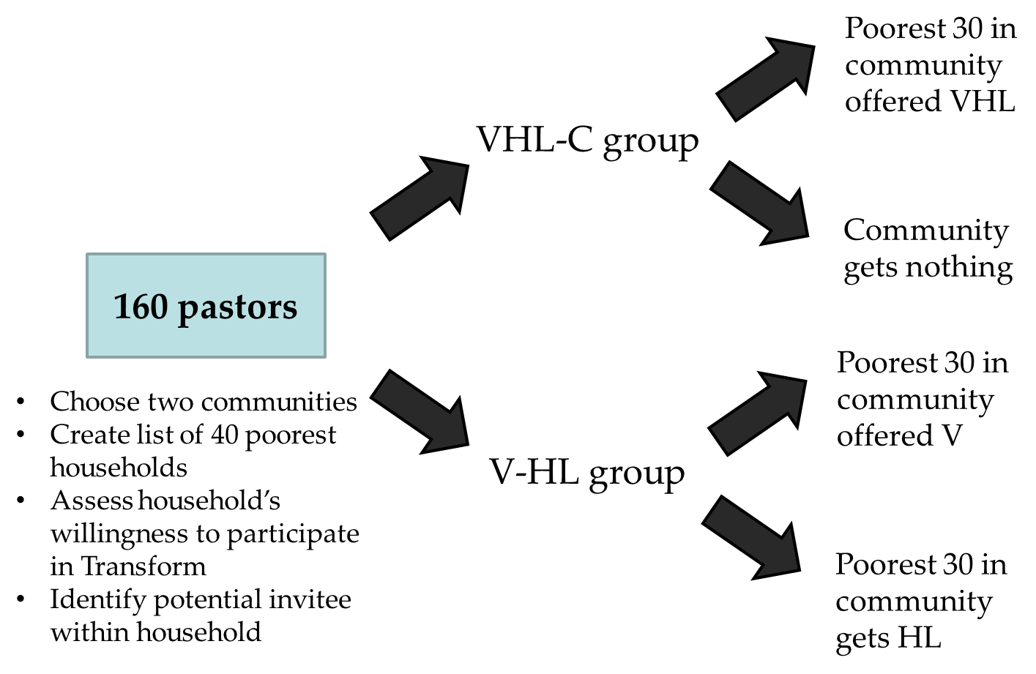
Design
Randomization
(2,010 participants)
(2,011 participants)
(2,002 participants)
(2,000 participants)
Notes:
2 step randomization process:
First stage – Assign all pastors into one of two groups (VHL or C) (HL or V)
Second stage – Pastors will have their chosen communities randomly allocated into a different treatment arm.
Groups were stratified by base

Slide 38
Primary outcomes
Table 1. Main indices: Primary outcomes
 | 1 | 2 | 3 | 4 | 5 | 6 | 7 | 8 | 9 | 10
 | Religion Intrinsic Index | Religion Extrinsic Index | General Religion Index | Religion-List Randomization | Last month HH consumption (PHP) | Food security index | Last month HH income (PHP) | Labor supply - total adult hours | Life satisfaction index | Perceived relative economic wellbeing
Panel A: Pooled specification
Any V | 0.1019*** | 0.1294*** | 0.0770*** | 0.0498 | 0.0099 | 0.0106 | 388.6213*** | 0.9252 | 0.0159 | -0.1123**
 | (0.0238) | (0.0237) | (0.0229) | (0.0373) | (100.4963) | (0.0227) | (127.0902) | (1.0890) | (0.0224) | (0.0469)
 | [0.001] | [0.001] | [0.002] | [0.183] | [0.999] | [0.768] | [0.015] | [0.718] | [0.718] | [0.052]
Any HL | 0.0138 | -0.0208 | -0.0001 | -0.0300 | -105.2917 | -0.0447* | 127.9288 | -1.8114* | -0.0114 | -0.0423
 | (0.0238) | (0.0238) | (0.0230) | (0.0374) | (93.4550) | (0.0230) | (126.3230) | (1.0949) | (0.0226) | (0.0471)
Panel B: Simple specification
Values, Health and Livelihood (VHL) | 0.1149*** | 0.1086*** | 0.0769** | 0.0197 | -103.5729 | -0.0323 | 522.9018*** | -0.8916 | 0.0045 | -0.1509**
 | (0.0342) | (0.0375) | (0.0307) | (0.0537) | (159.7858) | (0.0370) | (175.7029) | (1.4150) | (0.0275) | (0.0667)
Health and Livelihood (HL) | 0.0467 | 0.0737 | -0.0296 | -0.0045 | -316.8271 | -0.0503 | 286.6650 | -0.1229 | -0.0348 | -0.0754
 | (0.0547) | (0.0646) | (0.0544) | (0.0552) | (202.6302) | (0.0514) | (277.7594) | (2.3845) | (0.0564) | (0.1123)
Values (V) | 0.1239** | 0.2038*** | -0.0296 | 0.0705 | -165.9626 | -0.0067 | 578.7454** | 2.9616 | -0.0234 | -0.1316
 | (0.0500) | (0.0638) | (0.0544) | (0.0567) | (209.3366) | (0.0500) | (285.3409) | (2.3181) | (0.0472) | (0.1185)
p-value for VHL = HL test | 0.244 | 0.602 | 0.055 | 0.615 | 0.305 | 0.722 | 0.389 | 0.748 | 0.487 | 0.502
q-value for VHL = HL test | [0.391] | [0.615] | [0.148] | [0.615]
p-value for V = C test | 0.0138 | 0.002 | 0.305 | 0.215 | 0.429 | 0.894 | 0.043 | 0.202 | 0.620 | 0.267
q-value for V = C test | [0.056] | [0.013] | [0.407] | [0.391] | [0.643] | [0.895] | [0.261] | [0.535] | [0.744] | [0.535]
Panel C: summary information
Control group mean | 0 | 0 | 0 | 0.606 | 5001 | 0 | 4213 | 79.58 | 0 | 3.242
Number of observations in VHL | 1578 | 1578 | 1578 | 1578 | 1578 | 1526 | 1452 | 1452 | 1578 | 1576
Number of observations in HL | 1549 | 1549 | 1549 | 1549 | 1549 | 1521 | 1440 | 1439 | 1549 | 1548
Number of observations in V | 1550 | 1550 | 1550 | 1550 | 1550 | 1517 | 1435 | 1434 | 1550 | 1547
Number of observations in C | 1599 | 1599 | 1599 | 1599 | 1599 | 1567 | 1490 | 1490 | 1599 | 1596
back
Notes:
Clustered standard errors by community in parentheses
*** p<0.01, ** p<0.05, * p<0.1

Slide 39

Questions?
dean.karlan@gmail.com
www.poverty-action.org/right-fit-evidence
rightfit@poverty-action.org

